Slide 1
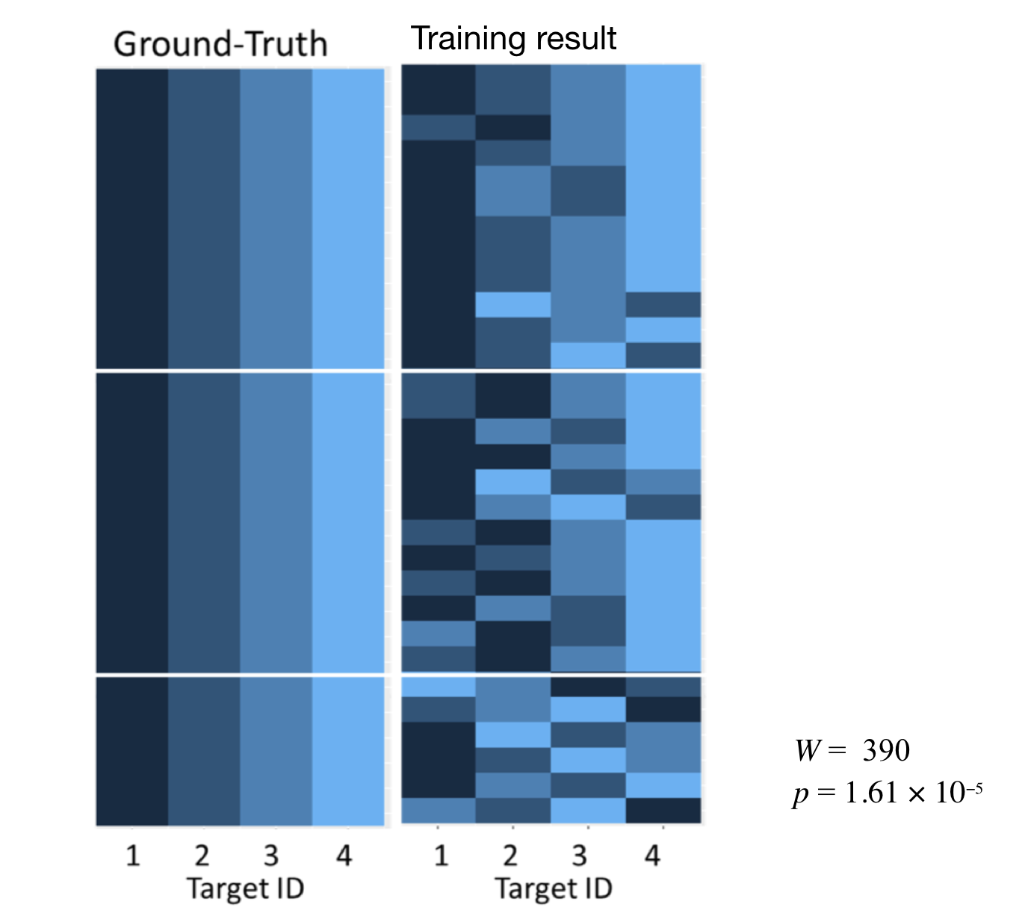
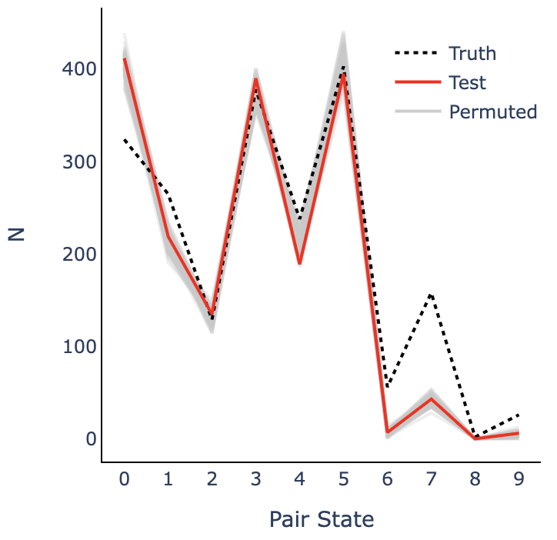
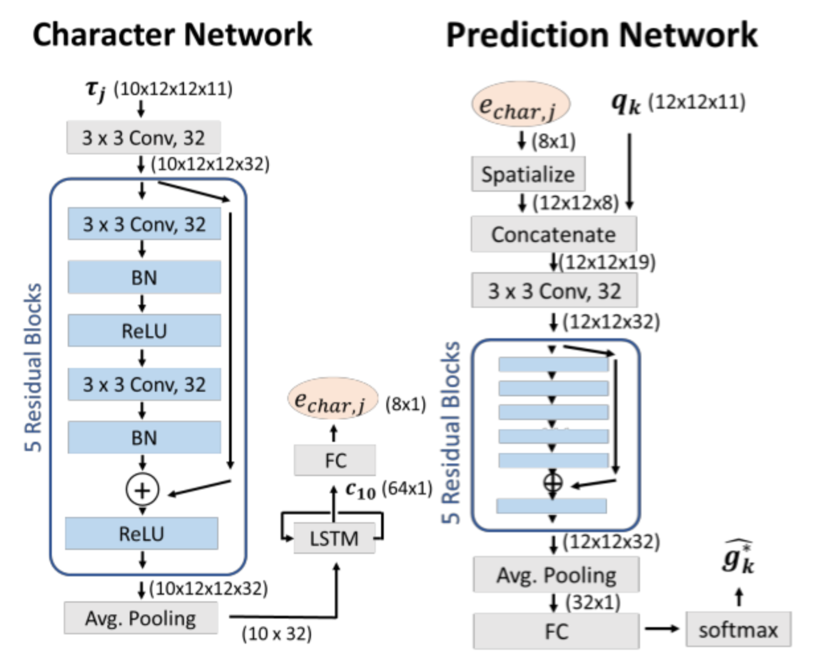
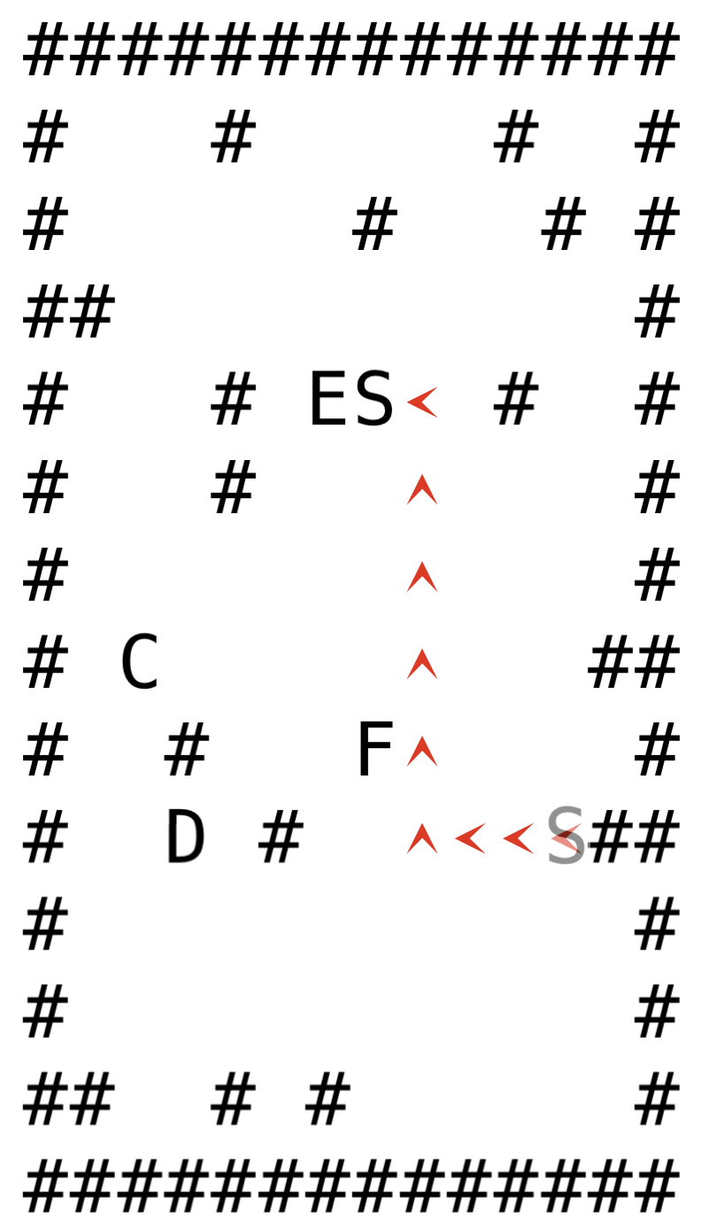
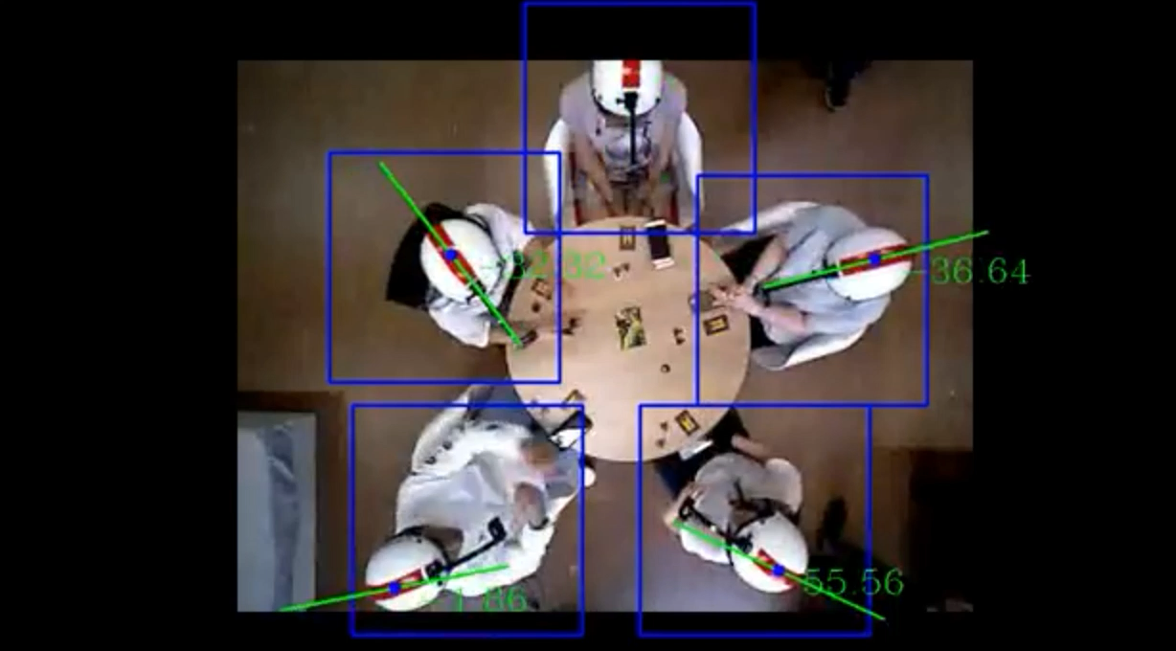
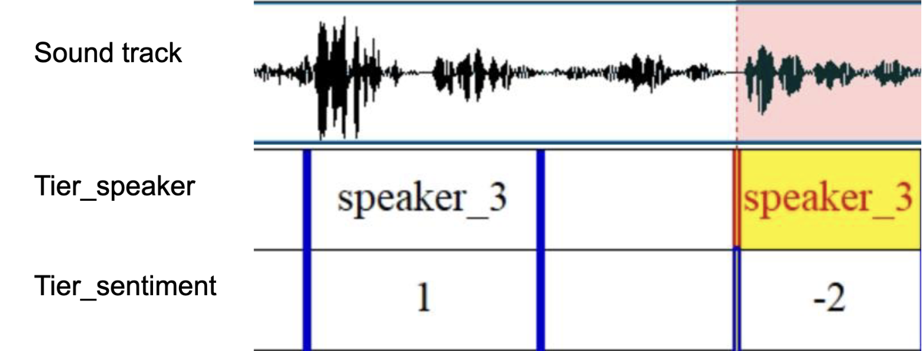
Re-generation of social preferences
A.
B.
C
C
E.g. one-to-four social network
F
D
8
F
2
S
6
D
E
S
10
E
Social preferences
E > C > D > F
>
>
>
>
>
>
>
>
Pairing Outcome States
Resultant social behavior
ToMNet-plus procedure
>
>
>
C.
Speaker
Valence
Fig. 1. A. Schematic showing an example social network with agent S’s preferences for the other four agents, which drives the agent’s approach behavior in Gridworld. ToMNet-plus observes the Gridworld trajectories and learns character embeddings for S, which are then used to predict behaviors in new Gridworld scenariors (published in Chuang et al., 2020, 29th IEEE RO-MAN, pp 1013). B. ToMNet 2.0 advances from ToMNet-plus by being able to handle social networks that include 5-way preferences that drive more dynamic Gridworld behaviors. ToMNet 2.0 predicts pairing outcome state vectors which are the prediction cases where a given pair of agents spatially converge (10 possible pairings in a 5-way social network). The manuscript for this work is in preparation. C. Sample human social preference behavior data. A top-down view is shown of 5 human participants socially engaging during a role-playing game (Avalon). The video tracks head orientation angles along with eye movements and facial expressions (not shown), and speech sound tracks. Information on behavioral expression target agent, valence in facial expression, and valence in speech is then obtained using human ratings and machine learning applications (data available upon reasonable request). NOTE: Top-down view is a playable video in PPT slide mode.
Notes:
The previous maze is one of our input simulation data, we generate total 10 thousand different mazes with the same set of social preference settings to train ToMnet.
(left)
After generating the simulation data set, we input the maze and the final goal together into ToMnet.
Note that without telling ToMnet the true social preference ranking, we trained Tomnet with mazes that represents these social preferences.
(right)
The structure showed in the right is a brief intro of ToMnet’s structure.
First, the input maze and the goal is fed into the char net. This char net arranges the input information, in other words, ToMnet is learning about what has just happened in this maze. This char net has two parts. The blue one is a kind of CNN, which digests the spatial information input. While the orange one is LSTM, this imports the temporal information, which is the movements of S by time.
(pred)
Then, after generating a summarize output from char net, the output will be fed into pred net. Pred net inputs another maze without the true goal. Together with the summarize output from the char net and the new maze, the Pred net outputs the predicted goal of the new maze. This output shows ToMnet’s thoughts about the recent social preference status.
This is the main structure of ToMnet.

Slide 2
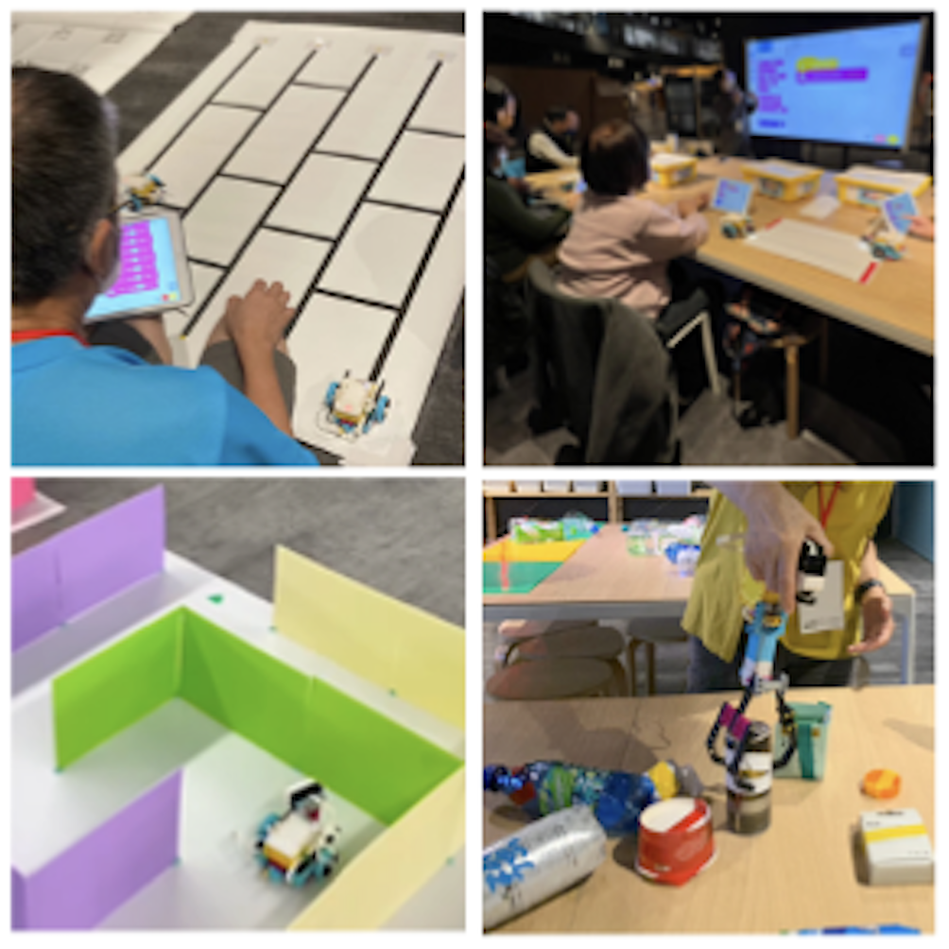
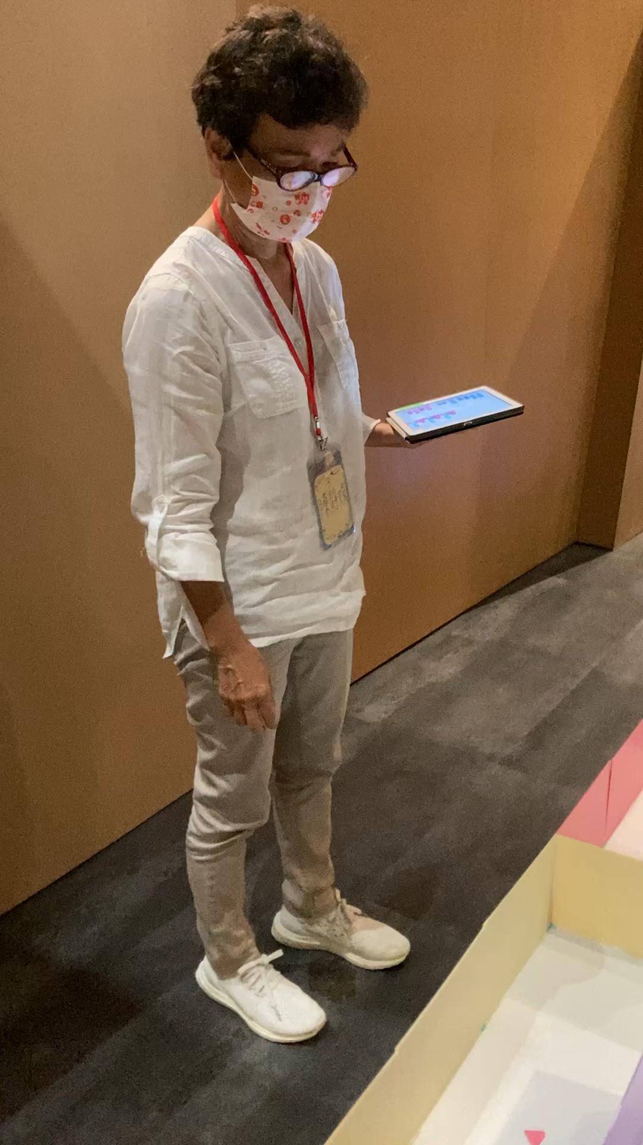
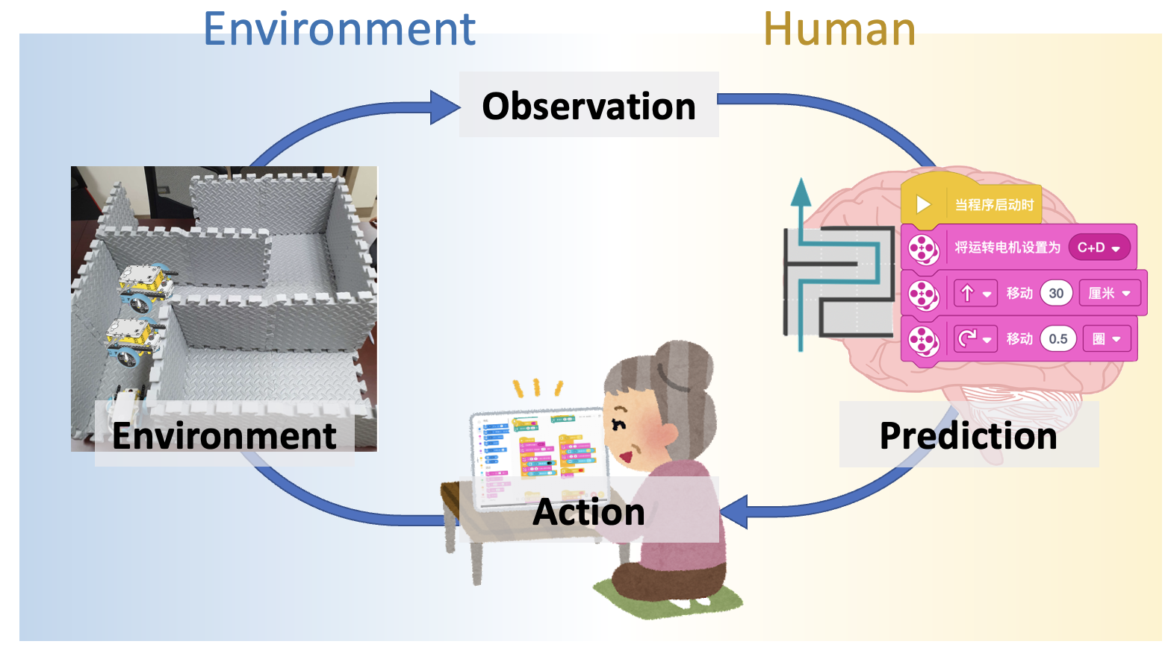
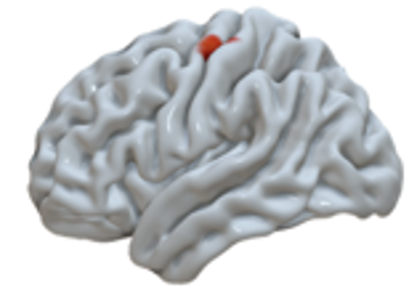
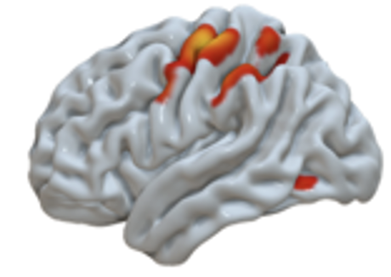
A.
B.
C.
Pre-training
Post-training
Fig. 2. A. Sample photographs showing older adult participants interacting with machines in the Lego Robot Programming training course conducted at the National Taiwan Science Education Center. Participants are shown learning the Scratch programming interface to instruct robots to follow environmental cues, navigate mazes, and to manipulate objects. NOTE: the left panel is a playable video in PPT slide mode (please do not publicly share this slide due to participant identity privacy issues). B. Schematic illustrating our hypothesis about how robot programming stimulates older adults to update their inferences about environmental causes by updating their programming codes in response to observations of the environment in relation to their actions (program codes). C. Preliminary results showing brain activity during inferential processing in a sub-set of participants before and after undergoing the 12-week Lego Robot Programming training course.

